Slide 1
EMBEDDED SYSTEM

Slide 2
What is an Embedded system?
•
An embedded system is one that has computer hardware with software embedded in it as one of
its components.
Or
We can define an embedded system as “A microprocessor based system that does not look like a computer”.
Or
we can say that it is “A combination of computer hardware and software, and perhaps additional mechanical or other parts, designed to perform a dedicated function. In some cases, embedded systems are part of a larger system or product, as is the case of an antilock braking system in a car. ”.

Slide 3
An embedded system is a special-purpose computer system designed to perform certain dedicated functions. It is usually embedded as part of a complete device including hardware and mechanical parts.

Slide 4
Why not use PCs for all embedded computing?
First, real-time performance requirements often drive us to different architectures, real-time performance is often best achieved by multiprocessors.
Second, low power and low cost also drive us away from PC architectures and toward multiprocessors.

Slide 5
Challenges in Embedded System Development
Embedded software is always a constituent of a larger system, for instance, a digital watch, a smartphone, a vehicle or automated industrial equipment.
Such embedded systems must have real-time response under all circumstances within the time specified by design and operate under the condition of limited memory, processing power and energy supply.
Moreover, embedded software must be immune to changes in its operating environment – processors, sensors, and hardware components may change over time.

Slide 6
Challenge #1: Stability
Stability is of paramount importance. Unexpected behavior from an embedded system is inadmissible and poses serious risks. End users demand that embedded systems must have uniform behavior under all circumstances and be able to operate durably without service.
Challenge #2: Safety
Safety is a special feature of embedded systems due to their primary application associated with lifesaving functionality in critical environments. Software Development Life Cycle (SDLC) for embedded software is characterized by more strict requirements and limitations in terms of quality, testing, and engineering expertise

Slide 7
Challenge #3: Security
Security became a burning issue in the digital world. The related risks grow exponentially, especially so for IoT devices gaining popularity worldwide and becoming more interconnected to each other. Because modern home appliances like electric cookers, refrigerators and washing machines have connectivity feature integrated by default, Internet of Things now is exposed to a serious risk of hacking attacks.
Challenge #4: Launch Phase
Time-to-market and time-to-revenue have always been tough indicators in embedded system development, especially in the IoT segment. That is why the apps and platforms supposed to support zillions of IoT devices expected to appear by 2020 still are in their concept stage. Fabrication of hardware components housing embedded systems require extreme integration and flexibility due to very fast development of IoT industry. In addition, taking into account longer IoT device lifespan, future updates and releases become an issue for component designers.

Slide 8
Challenge #5: Design Limitations
The challenges in design of embedded systems have always been in the same limiting requirements for decades:
Small form factor;
Low energy;
Long-term stable performance without maintenance.
The market demands from designers to pack more processing power and longer battery life into smaller spaces, which is often a tradeoff. Finally, depending on applications in IoT, there is a growing demand for manufacture of very scalable processor families ranging from cheap and ultra-low-power to maximum performance and highly configurable processors with forward-compatible instruction set. There is similar demand for increased performance of system buses and internal/external memory caches.

Slide 9
Challenge #6: Compatibility and Integrity
Gartner Group estimation shows that, presently, most of the apps in the market are launched by businesses younger than 3 years old. With all their probable expertise in software development, many of them lack hands-on experience in implementing and updating their applications in IoT environment, especially with regard to security implications.
Further expansion of IoT devices on the background of their connectivity puts more pressure on their adaptability. Users must be capable of administering the app through a simple user interface via all available channels including over-the-air firmware updates, which needs extreme compatibility across the entire ecosystem.
Integrity becomes a function of security. To protect the IoT from malicious attacks or compromising, security must be implemented within each device at every level: the end node, gateway, cloud, etc.

Slide 10
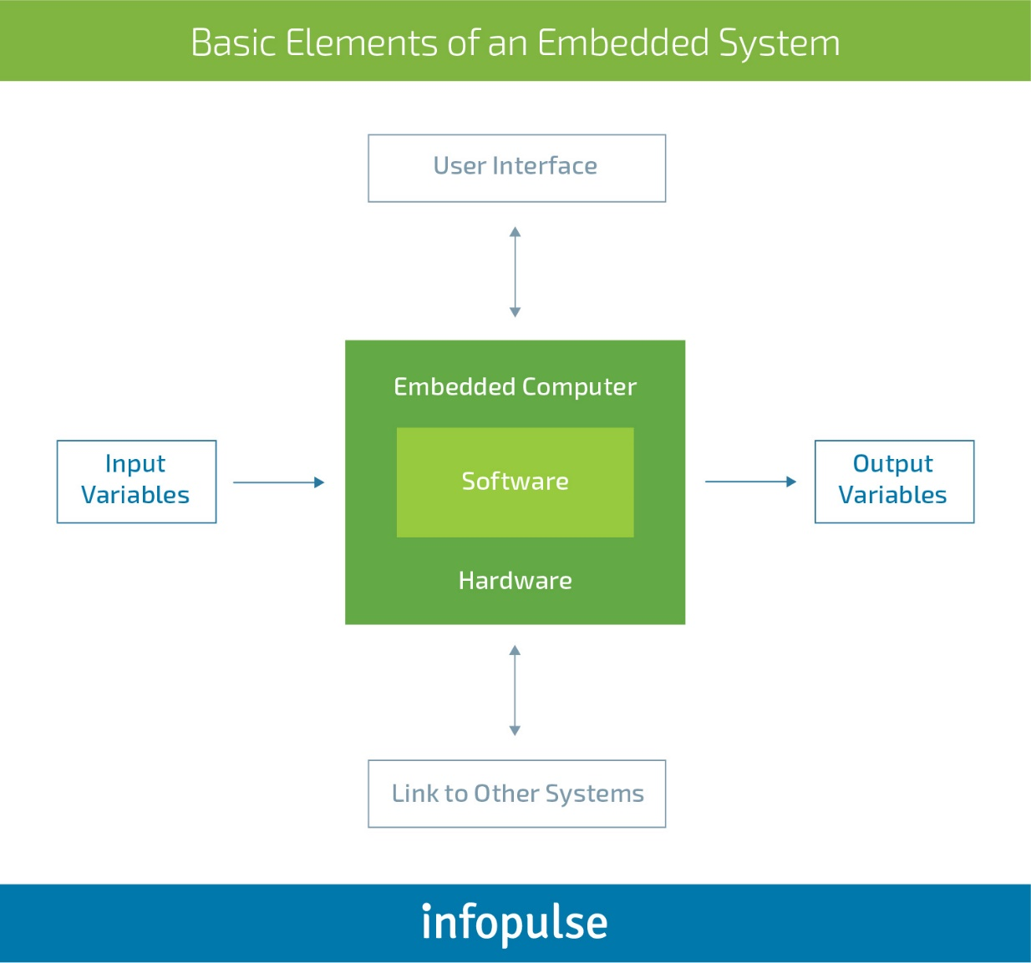

Slide 11
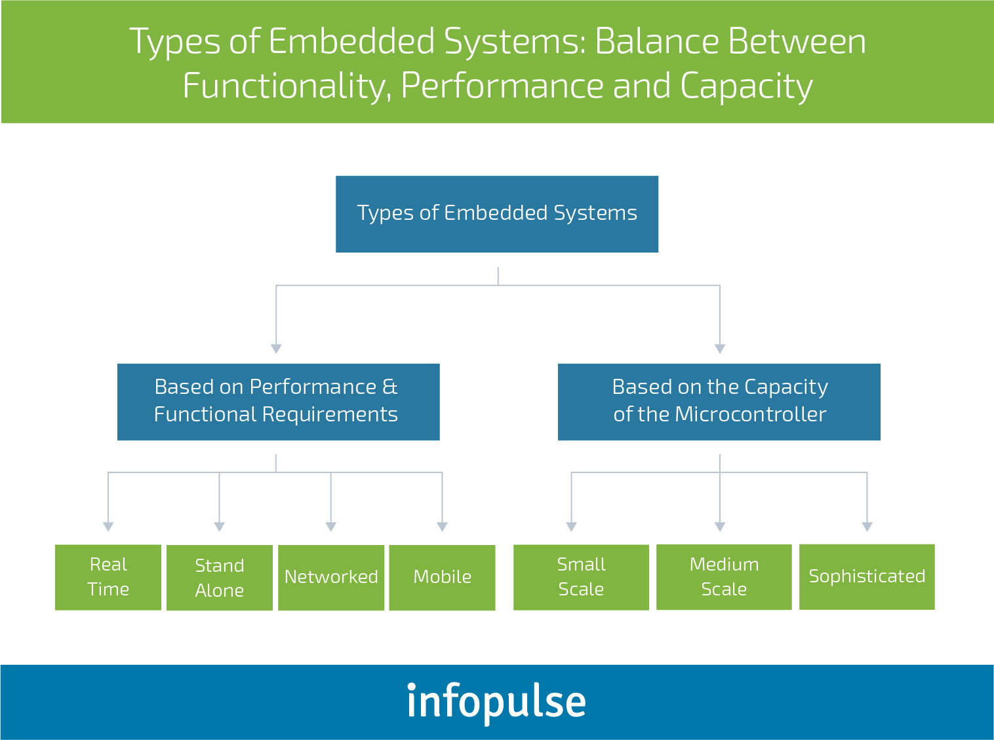

Slide 12
Significance
Due to their compact size, low cost and simple design aspects embedded systems are very popular and encroached into human lives and have become indispensable. They are found everywhere from kitchen ware to space craft. To emphasize this idea here are some illustrations.

Slide 13
Embedded systems everywhere?
Embedded systems span all aspects of modern life and there are many examples of their use.
Biomedical Instrumentation – ECG Recorder, Blood cell recorder, patient monitor system
Communication systems – pagers, cellular phones, cable TV terminals, fax and transreceivers, video games and so on.
Peripheral controllers of a computer – Keyboard controller, DRAM controller, DMA controller, Printer controller, LAN controller, disk drive controller.

Slide 14
Industrial Instrumentation – Process controller, DC motor controller, robotic systems, CNC machine controller, close loop engine controller, industrial moisture recorder and controller.
Scientific – digital storage system, CRT display controller, spectrum analyzer.

Slide 15
Were the embedded systems existing earlier ?
Yes, We have been enjoying the grace of embedded system quite a long time. But they were not so popular because in those days most of the embedded systems were designed around a microprocessor unlike today’s systems which were built around a microcontroller.
As we know a microprocessor by itself do not possess any memory, ports etc. So everything must be connected externally by using peripherals like 8255, 8257, 8259 etc. So the embedded system designed using microprocessor was not only complicated in design but also large in size. At the same time the speed of microprocessor is also a limitation for high end applications.

Slide 16
What is inside an embedded system ?
Every embedded system consists of custom-built hardware built around a Central Processing Unit (CPU). This hardware also contains memory chips onto which the software is loaded. The software residing on the memory chip is also called the ‘firmware’.
The operating system runs above the hardware, and the application software runs above the operating system. The same architecture is applicable to any computer including a desktop computer. However, there are significant differences. It is not compulsory to have an operating system in every embedded system.

Slide 17
For small appliances such as remote control units, air- conditioners, toys etc., there is no need for an operating system and we can write only the software specific to that application. For applications involving complex processing, it is advisable to have an operating system.
In such a case, you need to integrate the application software with the operating system and then transfer the entire software on to the memory chip. Once the software is transferred to the memory chip, the software will continue to run for a long time and you don’t need to reload new software.

Slide 18
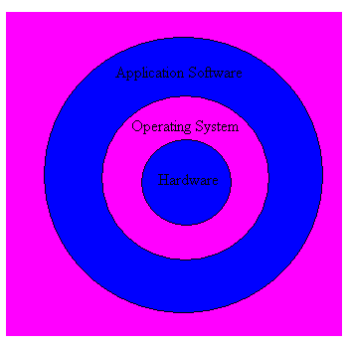
Layered architecture of an Embedded System

Slide 19
Now let us see the details of various building blocks of the hardware of an embedded system.
•
•
•
•
•
•
Central Processing Unit (CPU)
Memory (Read only memory and Random access memory) Input Devices
Output Devices Communication interfaces Application specific circuitry

Slide 20
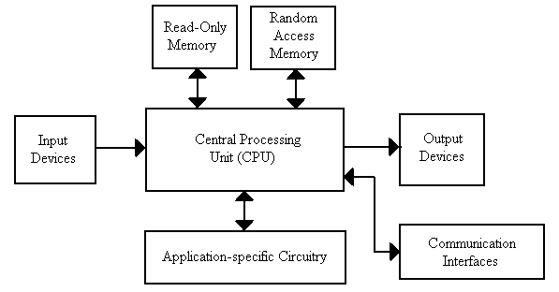
Hardware architecture of an embedded system

Slide 21
Features of an embedded system
Embedded systems do a very specific task, they cannot be programmed to do different things.
Embedded systems have very limited resources, particularly the memory. Generally, they do not have secondary storage devices such as the CDROM or the floppy disk.
Embedded systems have to work against some deadlines. A specific job has to be completed within a specific time. In some embedded systems, called real-time systems, the deadlines are stringent. Missing a dead line may cause a catastrophe – loss of life or damage to property.
•
Embedded systems are constrained for power, As many embedded systems operate through a battery, the power consumption has to be very low.

Slide 22
•
Embedded systems need to be highly reliable. Once in a while, pressing ALT-CTRL-DEL is OK on your desktop, but you cannot afford to reset your embedded system.
•
Some embedded systems have to operate in extreme environmental conditions such as very high temperatures and humidity.
•
Embedded systems that address the consumer market (for example electronic toys) are very cost-effective. Even a reduction of Rs.10 is lot of cost saving, because thousands or millions systems may be sold.
•
Unlike desktop computers in which the hardware platform is dominated by Intel and the operating system is dominated by Microsoft, there is a wide variety of processors and operating systems for the embedded systems. So, choosing the right platform is the most complex task .

Slide 23
Classification of Embedded Systems
Based on functionality and performance requirements,
embedded systems are classified as :
Stand-alone Embedded Systems
Real-time Embedded Systems
Networked Information Appliances
Mobile Devices

Slide 24
Stand-alone Embedded Systems
As the name implies, stand-alone systems work in stand-alone mode.
They take inputs, process them and produce the desired output.
The input can be electrical signals from transducers or commands from a human being such as the pressing of a button.
The output can be electrical signals to drive another system, an LED display or LCD display for displaying of information to the users.
Embedded systems used in process control, automobiles, consumer electronic items etc. fall into this category.

Slide 25
Real-time Systems
Embedded systems in which some specific work has to be done in a specific time period are called real-time systems.
For example, consider a system that has to open a valve within 30 milliseconds when the humidity crosses a particular threshold.
If the valve is not opened within 30 milliseconds, a catastrophe may occur.
Such systems with strict deadlines are called hard real-time systems.
In some embedded systems, deadlines are imposed, but not adhering to them once in a while may not lead to a catastrophe.
For example, consider a DVD player. Suppose, you give a command to the DVD player from a remote control, and there is a delay of a few milliseconds in executing that command. But, this delay won’t lead to a serious implication.
Such systems are called soft real-time systems .

Slide 26
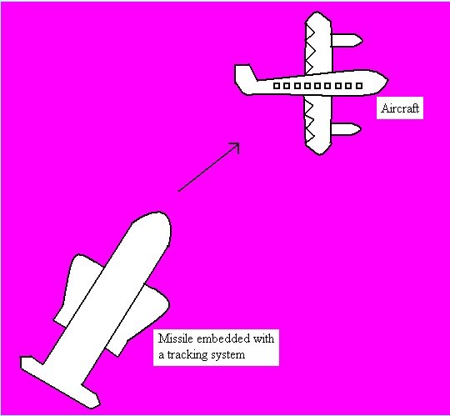
Hard Real-Time Embedded System

Slide 27
Networked Information Appliances
Embedded systems that are provided with network interfaces and accessed by networks such as Local Area Network or the Internet are called networked information appliances.
Such embedded systems are connected to a network, typically a network running TCP/IP (Transmission Control Protocol/Internet Protocol) protocol suite, such as the Internet or a company’s Intranet.
These systems have emerged in recent years. These systems run the protocol TCP/IP stack and get connected through PPP or Ethernet to a network and communicate with other nodes in the network.

Slide 28
Here are some examples of such systems
A networked process control system consists of a number of embedded systems connected as a local area network. Each embedded system can send real-time data to a central location from where the entire process control system can be monitored.
The monitoring can be done using a web browser such as the Internet Explorer.
A web camera can be connected to the Internet. The web camera can send pictures in real-time to any computer connected to the Internet. In such a case, the web camera has to run the HTTP server software in addition to the TCP/IP protocol stack.
The door lock of your home can be a small embedded system with TCP/IP and HTTP server software running on it. When your children stand in front of the door lock after they return from school, the web camera in the door-lock will send an alert to your desktop over the Internet and then you can open the door-lock through a click of the mouse.

Slide 29
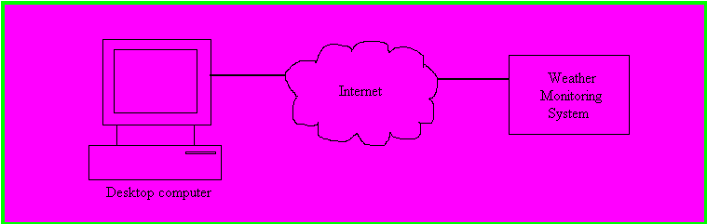
This image shows a weather monitoring system connected to the Internet. TCP/IP protocol suite and HTTP
web server software will be running on this system. Any computer connected to the Internet can access
this system to obtain real-time weather information.
The networked information appliances need to run the complete TCP/IP protocol stack including the
application layer protocols. If the appliance has to provide information over the Internet, HTTP web
server software also needs to run on the system.

Slide 30
Mobile Devices
Mobile devices such as mobile phones, Personal Digital Assistants (PDAs), smart phones etc. are a
special category of embedded systems. Though the PDAs do many general purpose tasks, they need to
be designed just like the ‘conventional’ embedded systems.
The limitations of the mobile devices – memory constraints, small size, lack of good user interfaces such
as full fledged keyboard and display etc. are same as those found in the embedded systems discussed
above. Hence, mobile devices are considered as embedded systems.
However, the PDAs are now capable of supporting general purpose application software such as
word processors, games, etc.

Slide 31
Communication Interfaces
For embedded systems to interact with the external world, a number of communication interfaces are available. They are
Serial Communication Interfaces (SCI): RS-232, RS-422, RS-485 etc
Synchronous Serial Communication Interface: I2C, JTAG, SPI, SSC and ESSI
Universal Serial Bus (USB)

Slide 32
•
Networks:
Ethernet, Controller Area Network, LonWorks, etc
•
Timers:
PLL(s), Capture/Compare and Time Processing Units
•
Discrete IO:
General Purpose Input/Output (GPIO)
•
Analog to Digital/Digital to Analog (ADC/DAC)

Slide 33
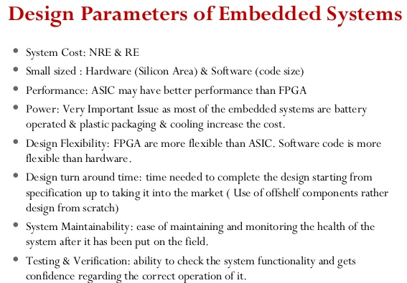

Slide 34
ES LIFE CYCLE:
Need/opportunity
Concept development
Manufacturing process design
Production
Deployment
Support/maintenance
Upgrades
Retirement/Disposals

Slide 35
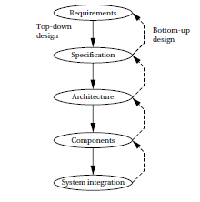
ES DESIGN PROCESS

Slide 36
Design Metrics
Power Dissipation
Performance
Process Deadlines
User Interfaces
Size
Engineering cost
Manufacturing cost
Flexibility
Prototype development Time
Time-to- market System
User safety Maintenance

Slide 37
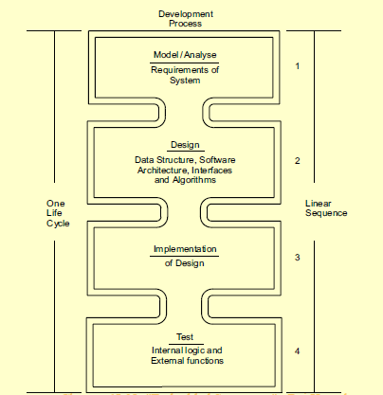
Software Design Cycle

Slide 38
Hardware/Software Codesign
A definition:
Meeting System level objectives by exploiting
the synergism of hardware and software
through their concurrent design

Slide 39
Why codesign?
Reduce time to market
Achieve better design
Explore alternative designs
Good design can be found by balancing the HW/SW
To meet strict design constraint
power, size, timing, and performance trade-offs
safety and reliability
system on chip

Slide 40
Concurrent design
Traditional design flow
Concurrent (codesign) flow
start
start
HW
SW
HW
SW
Designed by independent
groups of experts
Designed by Same group of
experts with cooperation

Slide 41
Typical codesign process
System
Description
Modeling
HW/SW
Partitioning
Unified representation
Software
synthesis
Interface
synthesis
Hardware
synthesis
System
integration
Instruction set level
HW/SW evaluation

Slide 42
HW/SW Co-design: Main Advantages
To explore different design alternatives.
• To evaluate cost-performance trade-offs
• To reduce system design time
⇒ Reduction of product time-to-market and cost
• To improve product quality through design process optimization
• To support system-level specifications
⇒ To facilitate the reuse of hardware and software parts.
• To provide an integrated framework for the synthesis and validation of hardware and software components.

